Slide 1
Data Analysis and Visualization Report: Exploring Economic, Demographic, and Health Indicators

Slide 2
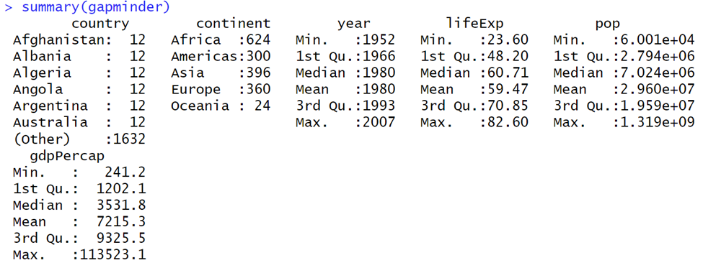
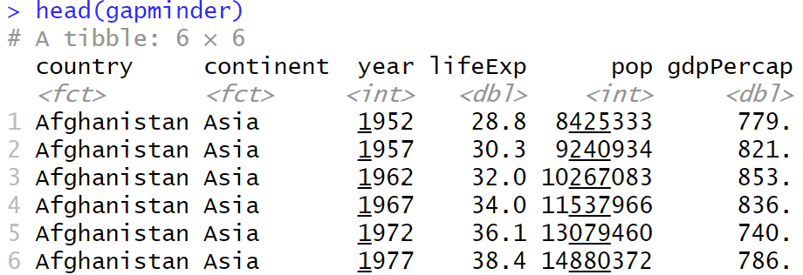
Overview of Gapminder Dataset
The Gapminder dataset provides a comprehensive collection of key indicators for a wide range of countries across different years.
GDP per capita: A measure of a country's economic output per person.
Life expectancy: The average number of years a person can expect to live in a particular country.
Population: The total number of people living in a country.
Continent: The geographical classification of each country.

Slide 3

Introduction to Key Analysis Areas
Economic Indicators
Population and Demographics
Health and Life Expectancy
Combined Economic and Demographic Trends

Slide 4
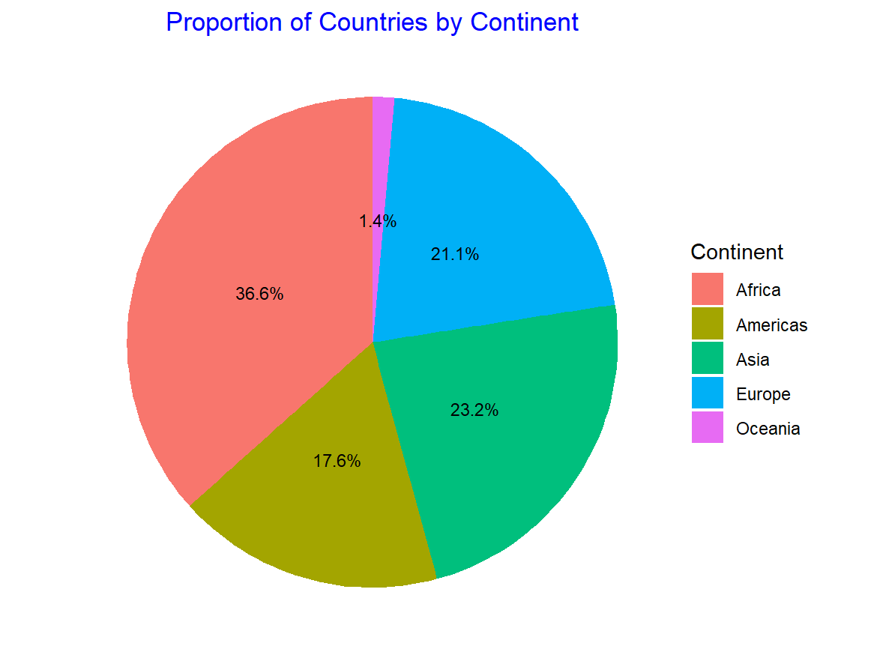
Proportion of Countries by Continent
Asia and Africa have the highest number of countries.
Oceania and Europe represent fewer countries compared to the other continents.
This visualization highlights the disparity in the number of countries across different continents.

Slide 5
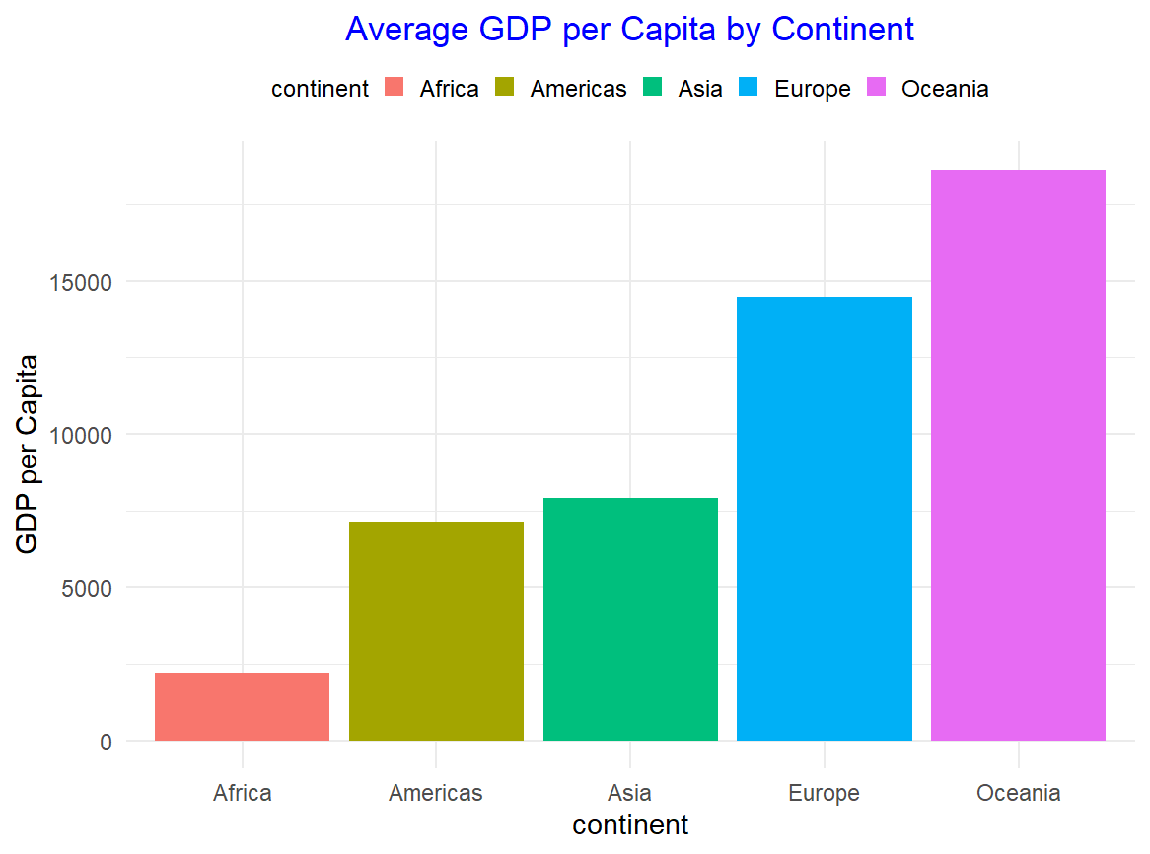
Average GDP per Capita by Continent
Europe and Oceania have the highest average GDP per capita, far surpassing other continents.
Africa has the lowest average GDP per capita, highlighting its economic challenges.

Slide 6
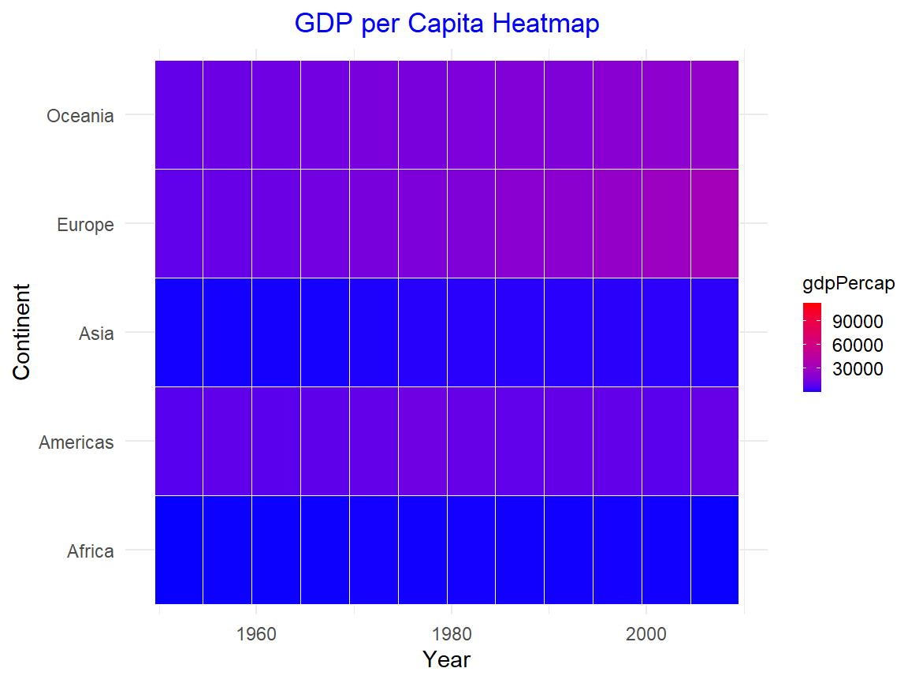
GDP per Capita Across Continents and Years
Economic Growth: with notable sharp rises in Europe and North America, indicating periods of robust economic growth.
Consistent Disparity in Africa: Africa consistently had lower GDP per capita across all years.

Slide 7
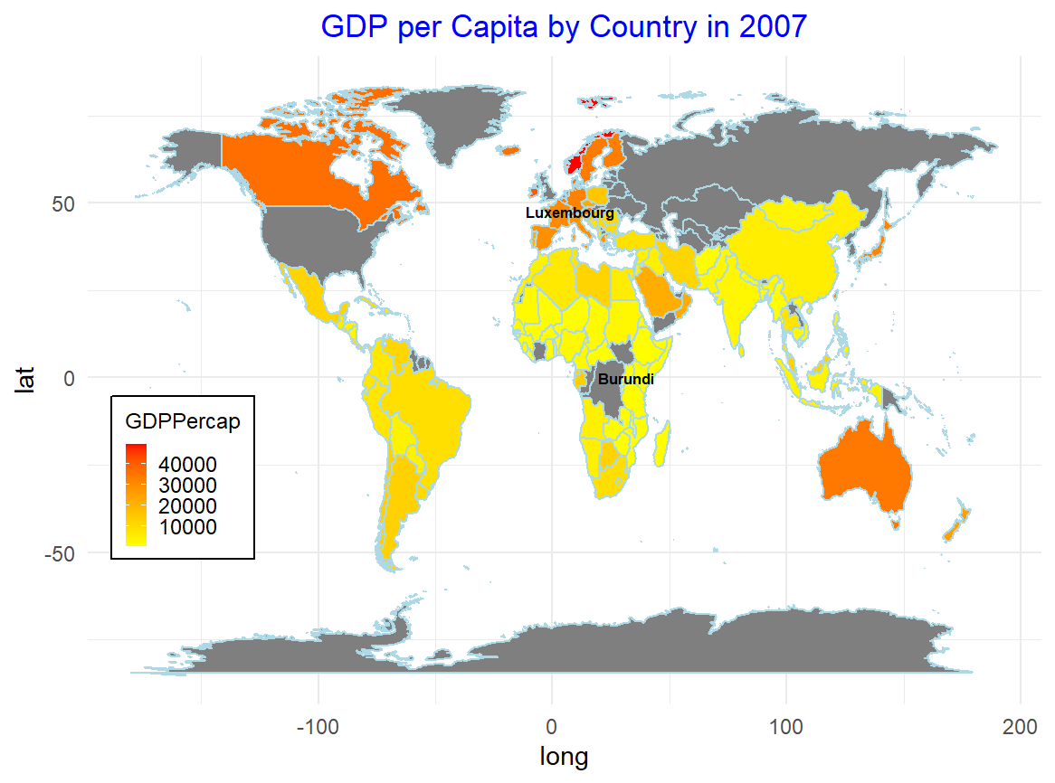
GDP per Capita by Country in 2007
High GDP per capita in countries like Luxembourg, the United States, and other nations in North America and Europe.
Lower GDP per capita in countries such as Burundi and other nations in Africa, emphasizing stark global inequalities.

Slide 8
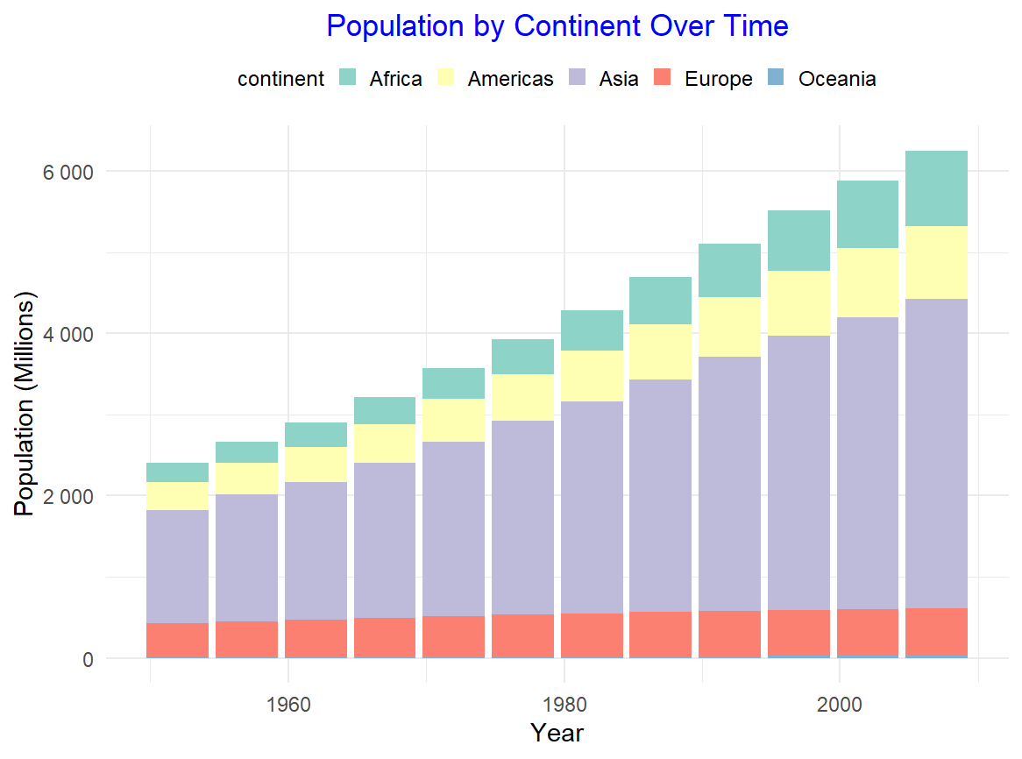
Population by Continent Over Time
Asia: The largest population increase, with China and India contributing significantly to the rise.
Africa: Rapid population growth, reflecting high birth rates and improving life expectancy.
Europe: Population growth has slowed, and in some countries, it has even declined during this period.

Slide 9
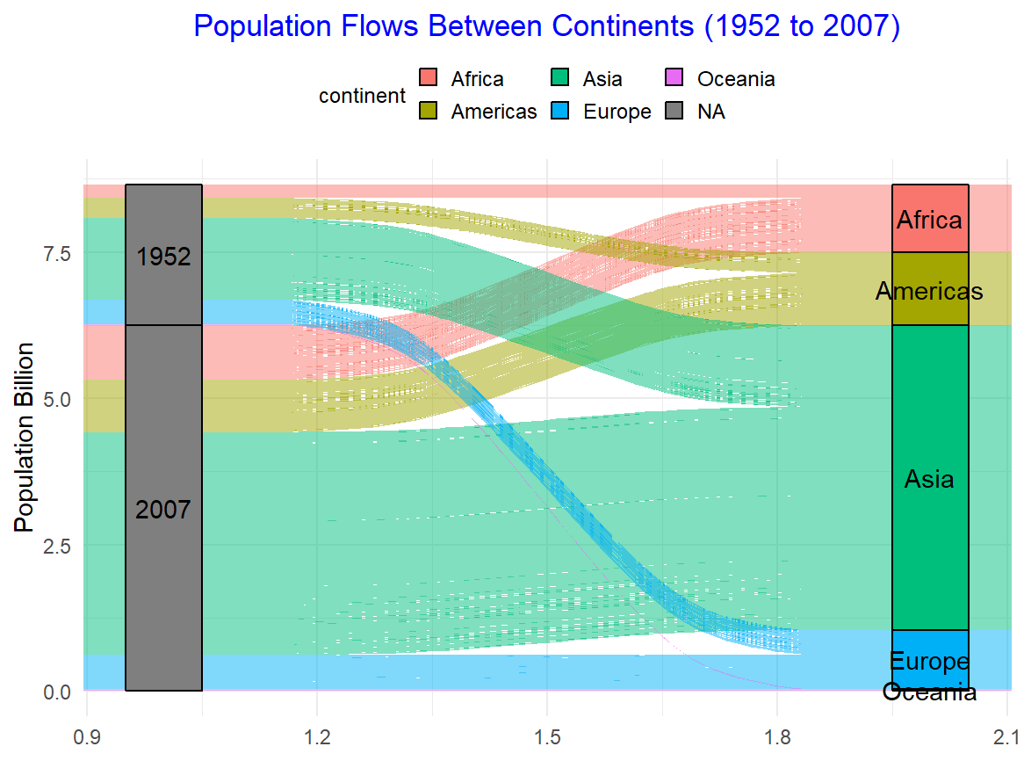
Population Flows Between Continents (1952 to 2007)
Asia & Africa: Significant population growth, reflecting high birth rates and migration.
Europe & North America: Minimal changes, with some countries experiencing slow growth or decline.

Slide 10
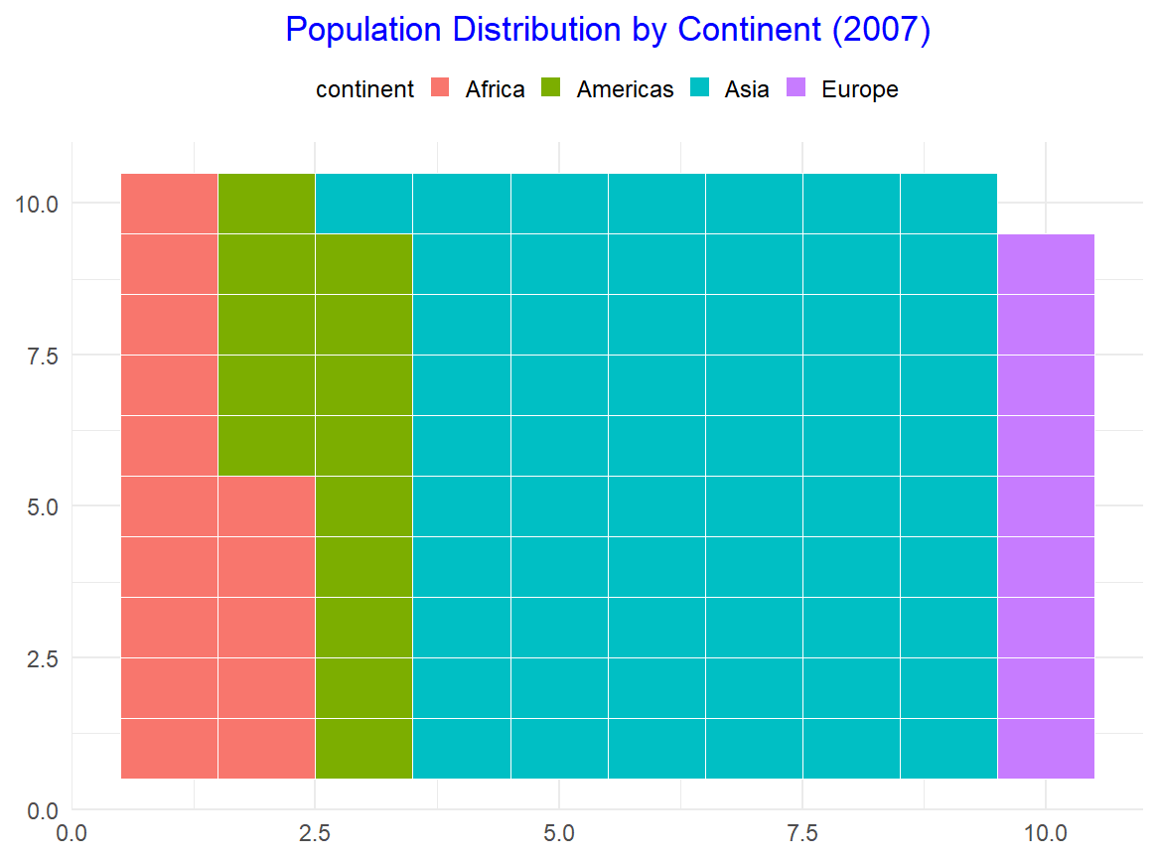
Population Distribution by Continent (2007)
Asia and Africa dominate the global population, with Asia having the largest share.
Europe and Oceania have much smaller shares of the global population.

Slide 11
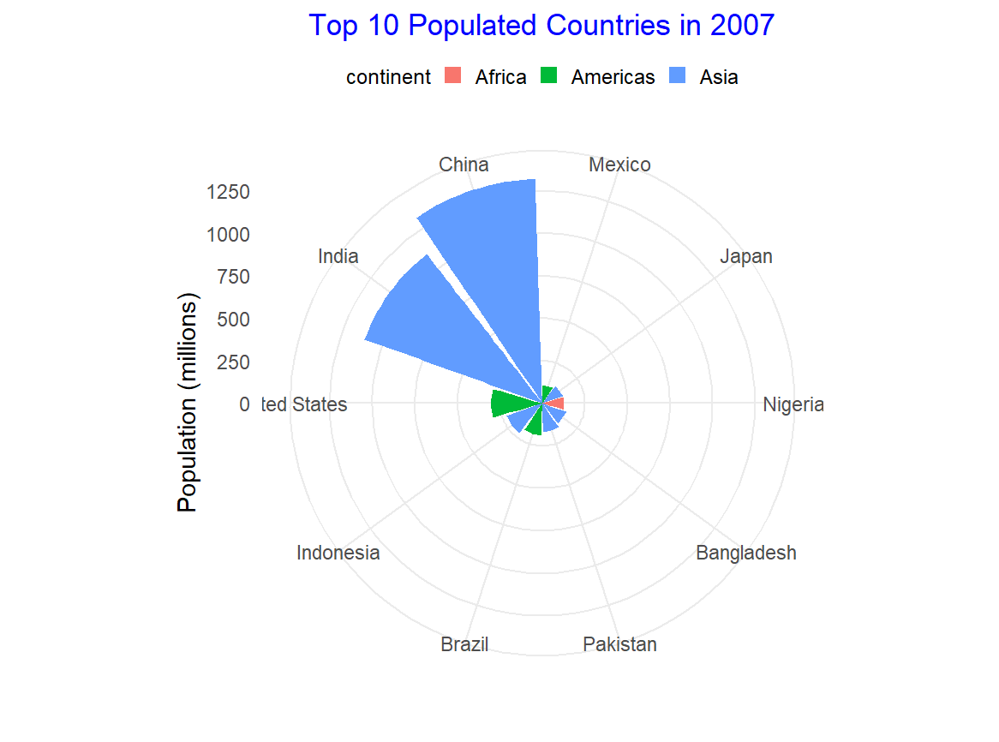
Top 10 Populated Countries in 2007
China and India dominate the global population landscape, with the largest populations by far.
United States and Indonesia follow as the next most populous countries.

Slide 12
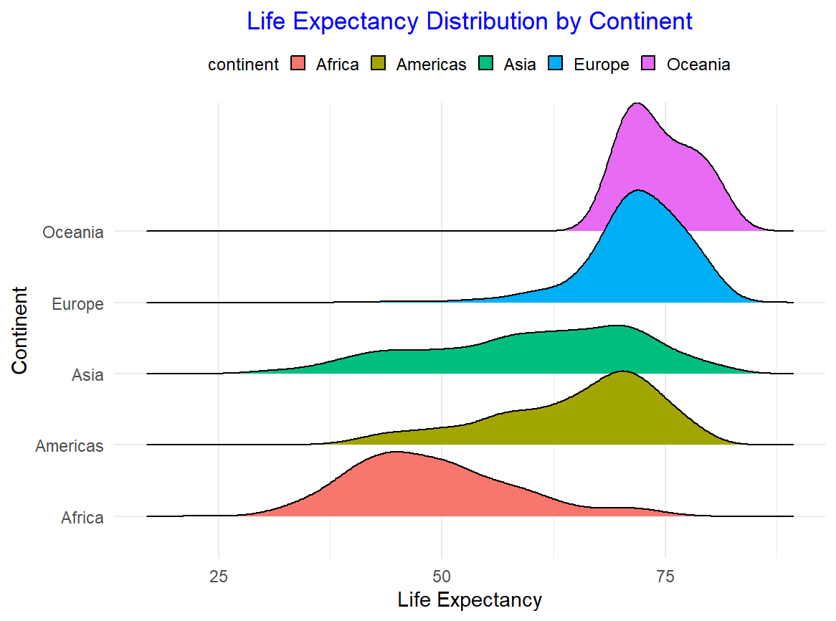
Life Expectancy Distribution by Continent
Europe and Oceania generally have higher life expectancies compared to other continents.
Africa has the lowest life expectancy across the continents, highlighting significant health disparities.

Slide 13
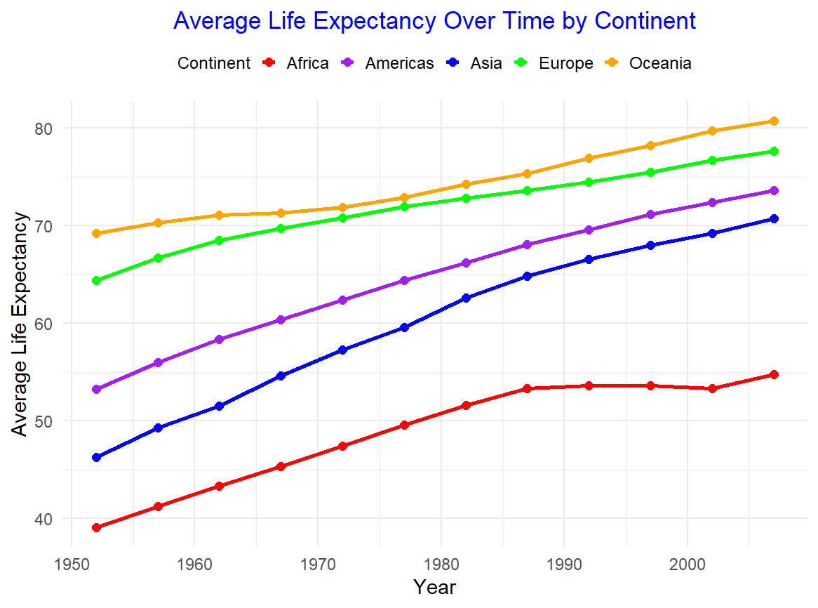
Average Life Expectancy Over Time by Continent
A general upward trend in life expectancy across all continents.
Europe and Oceania have seen the most significant improvements in life expectancy over the years.
Africa still lags behind, with lower life expectancy rates, highlighting ongoing health challenges in the region.

Slide 14
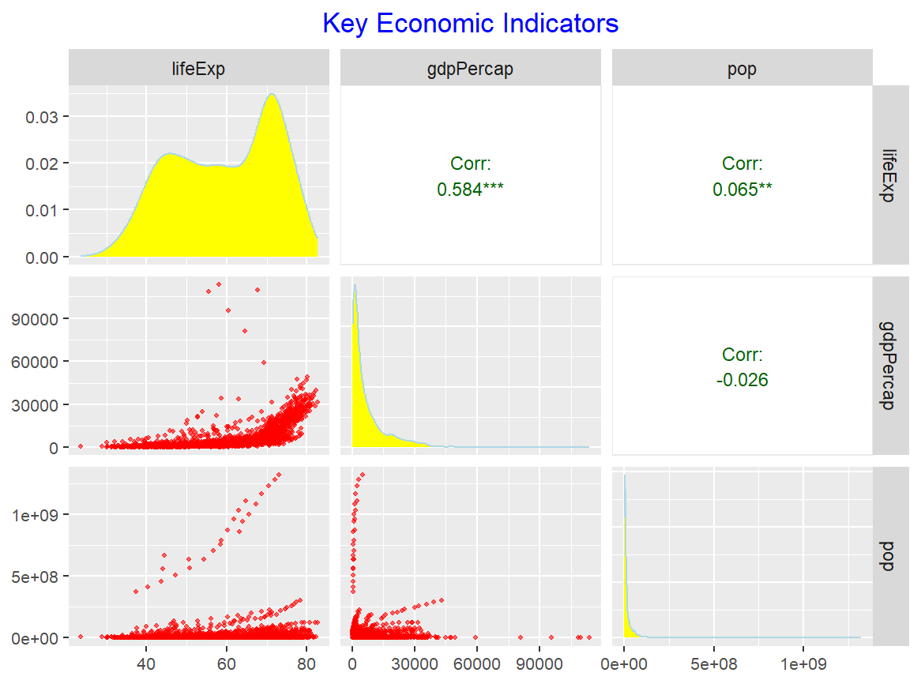
Key Economic Indicators
GDP per capita vs. Life Expectancy: Countries with higher GDP per capita tend to have higher life expectancy
Population vs. Life Expectancy: Larger populations do not necessarily correlate with higher life expectancy.

Slide 15
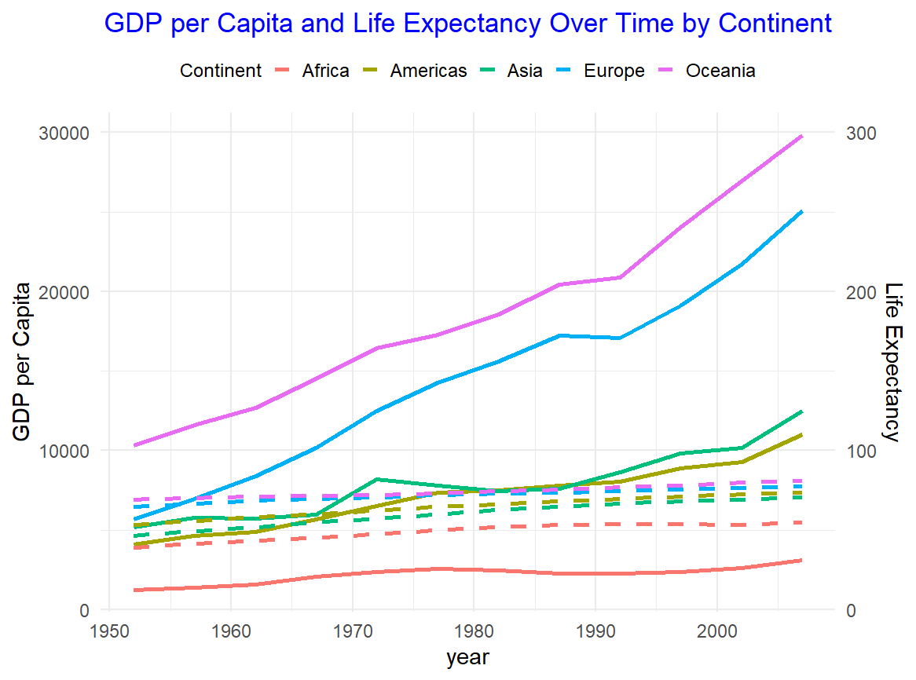
GDP per Capita and Life Expectancy Over Time
Economic Growth
Health Improvements
Relationship Between Economic Growth and Health
Variation Across Continents

Slide 16
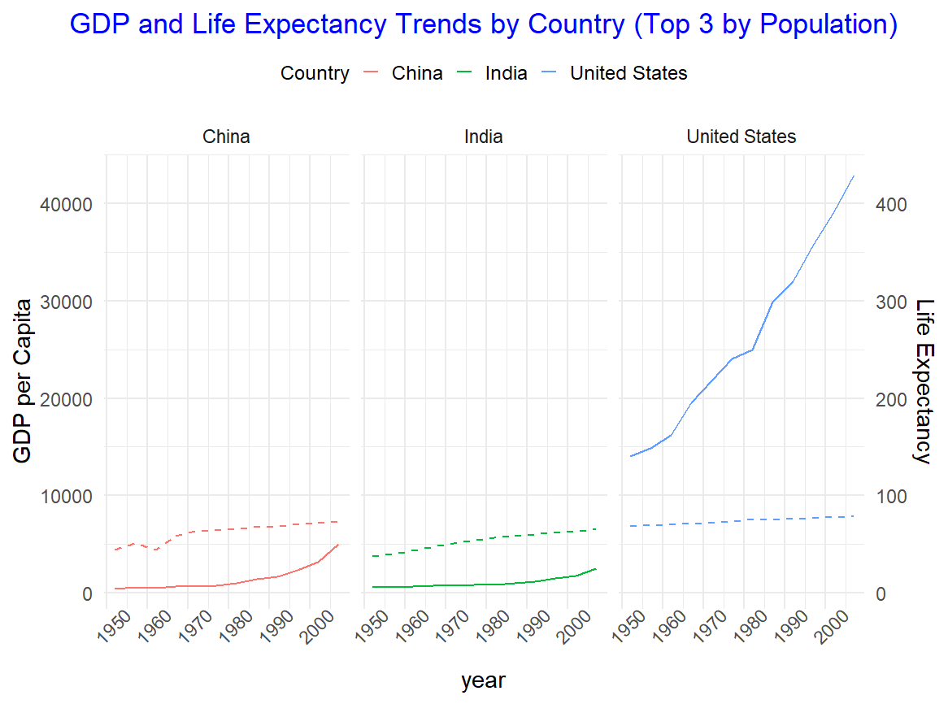
GDP and Life Expectancy Trends for Top 3 Countries
United States: Has experienced consistent economic growth and a steady increase in life expectancy over time.
China and India: Both countries have seen rapid improvements in GDP and life expectancy, especially in the past few decades, indicating significant development in both economic and health sectors.

Slide 17
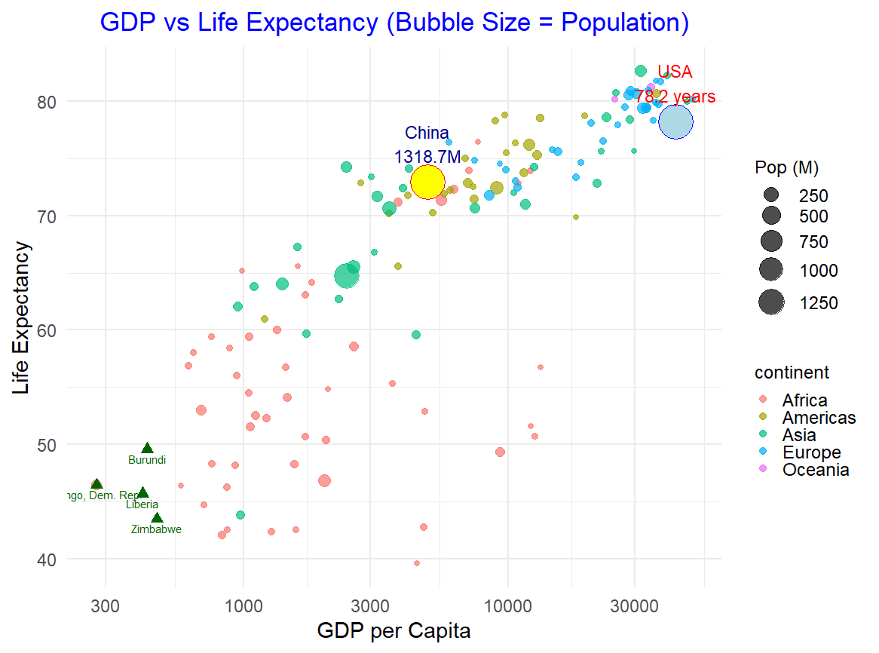
GDP vs Life Expectancy (Bubble Plot)
Large Countries.
Low GDP, Low Life Expectancy
Global Landscape.

Slide 18
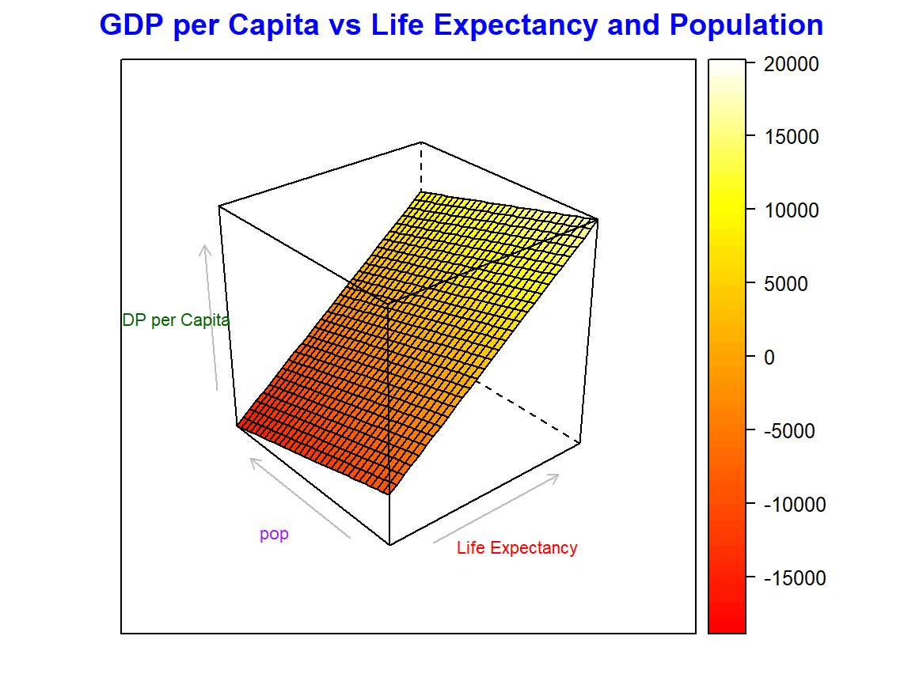
GDP vs Life Expectancy and Population
Larger populations tend to have lower GDP per capita and life expectancy, particularly in regions such as Africa and Asia.
https://rpubs.com/hainguyenquoc_vn/cloudplot3d

Slide 19
Thank you
Hai Nguyen Quoc
studentID: 140023
hn140023@student.sgh.waw.pl

